Slide 1




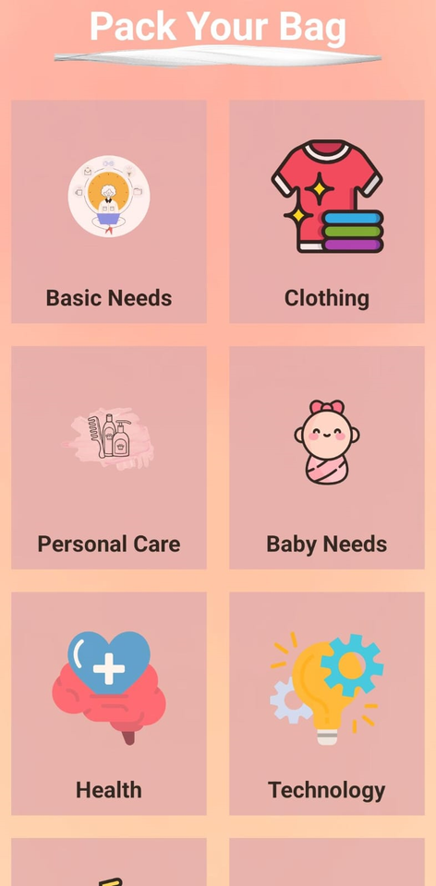
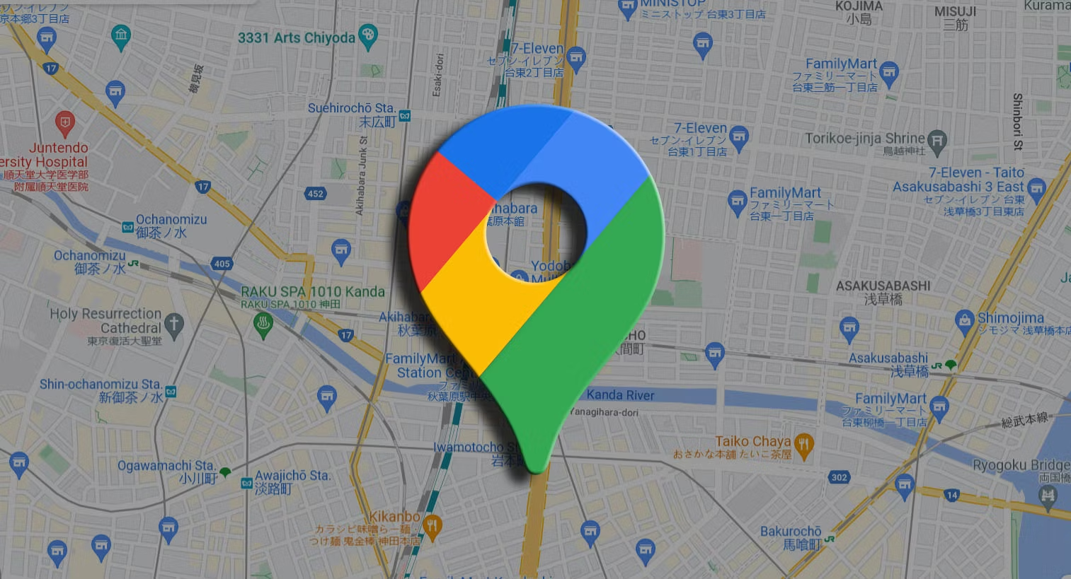
Android Mobile App Development(JAVA)
EDGE (CBI-017)
Introducing My App
PokeJøurnèÿ
for introducing us to the world of research 🌱 Our journey begins here, and we're truly grateful. We’ll always remember your help and support. 🙏💙

Slide 2




Submitted By:
Name: Nazrana Nahreen
ID: C231444
Department: CSE || Semester:4th
Course: Mobile App Development
EDGE (CBI:017)
International Islamic University Chittagong
Submitted To:
Instructor: RadiathunTasnia
Assistant Lecturer CSE, IIUC
EDGE (CBI:017)

Slide 3
Introduction
PokeJøurnèÿ is the ultimate travel companion app that helps users stay organized for every journey by creating and managing categorized packing lists, covering everything from basics and personal care to technology and baby essentials. Perfect for work trips or vacations, it ensures no essential item is left behind, making packing simple, organized, and stress-free.

Slide 4
Problem Statement
Travelers often forget important items when preparing for a journey, leading to inconvenience, delays, and added stress.
How This App Will Help
The objective is to ensure a smooth, stress-free travel experience by helping users organize and keep track of all necessary items for their journey.

Slide 5

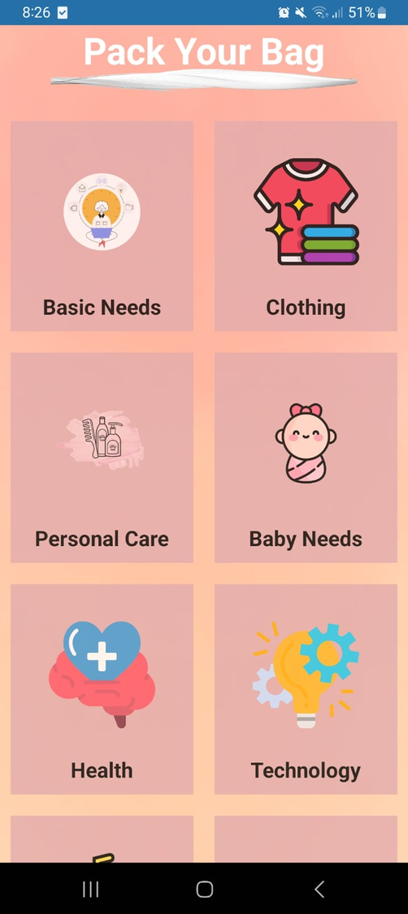
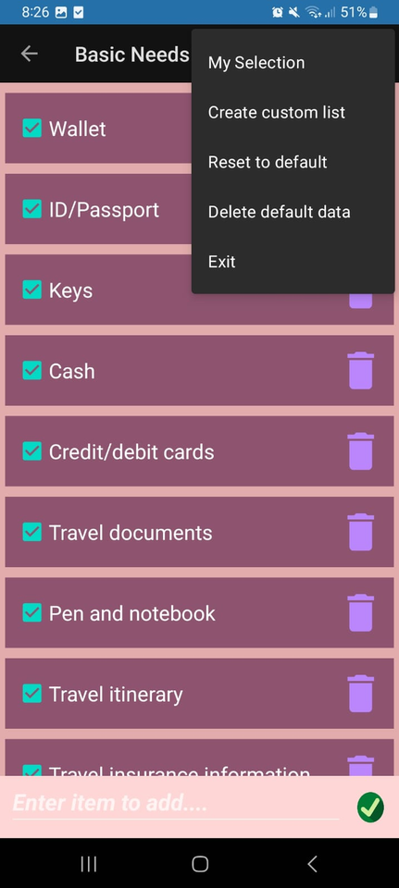
Features
Main Screen
My Selections
Category Selection
Functionality:
Create custom list
Reset to default
Delete default data
About Us
Exit
Item selection
Item Addition
Item Deletion

Slide 6
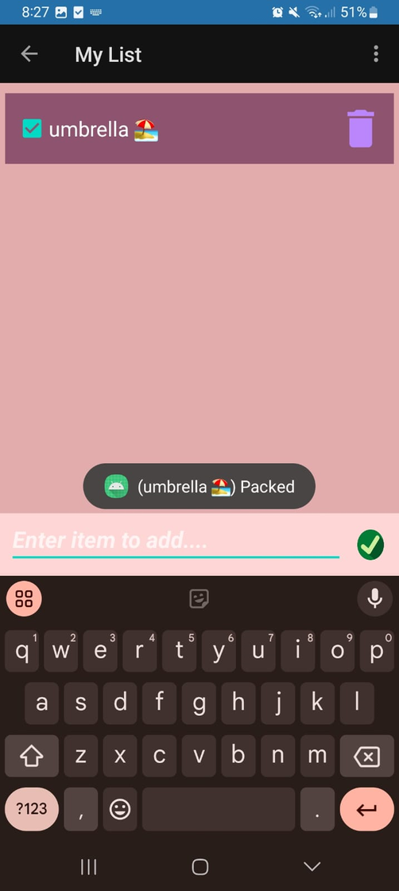
Features
user can delete the whole list or can delete only one item as their wish clicking on the icon
also user can check or uncheck the item
writing the item name user clicks on the check mark icon and the item added
Shows toast massage

Slide 7
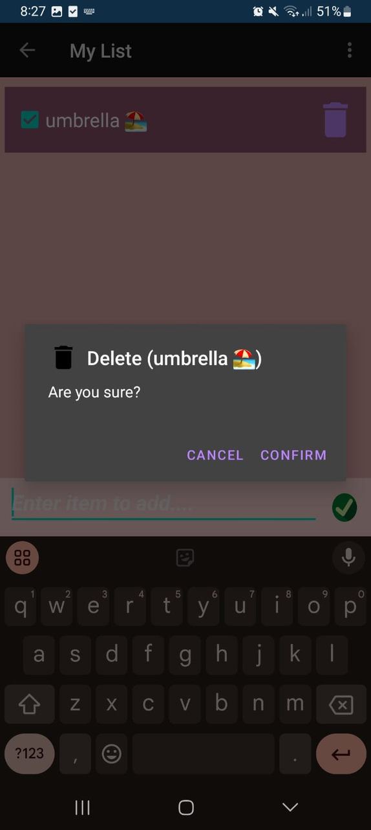

Features
customized list
can add new elements as their need
shows a confirmation msg before deleting item
can delete elements as their need

Slide 8
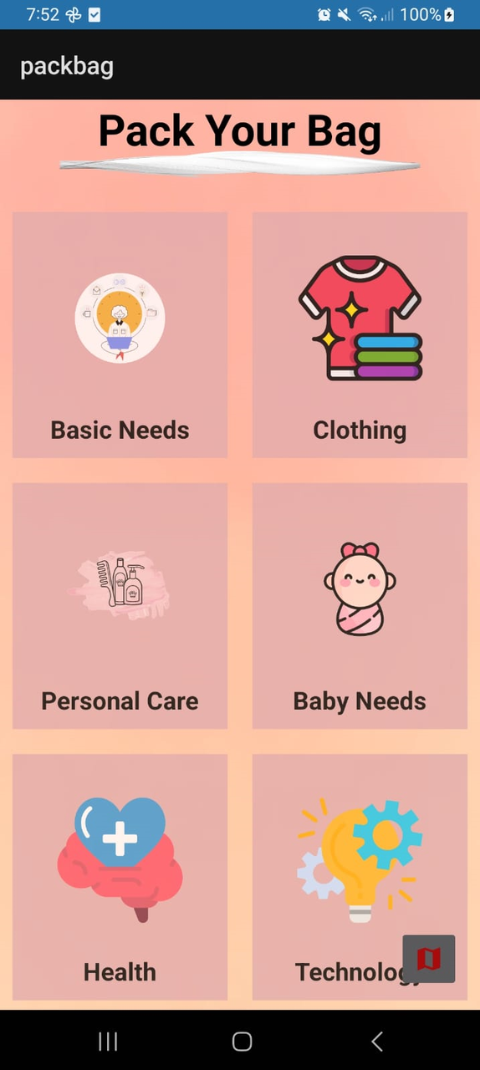
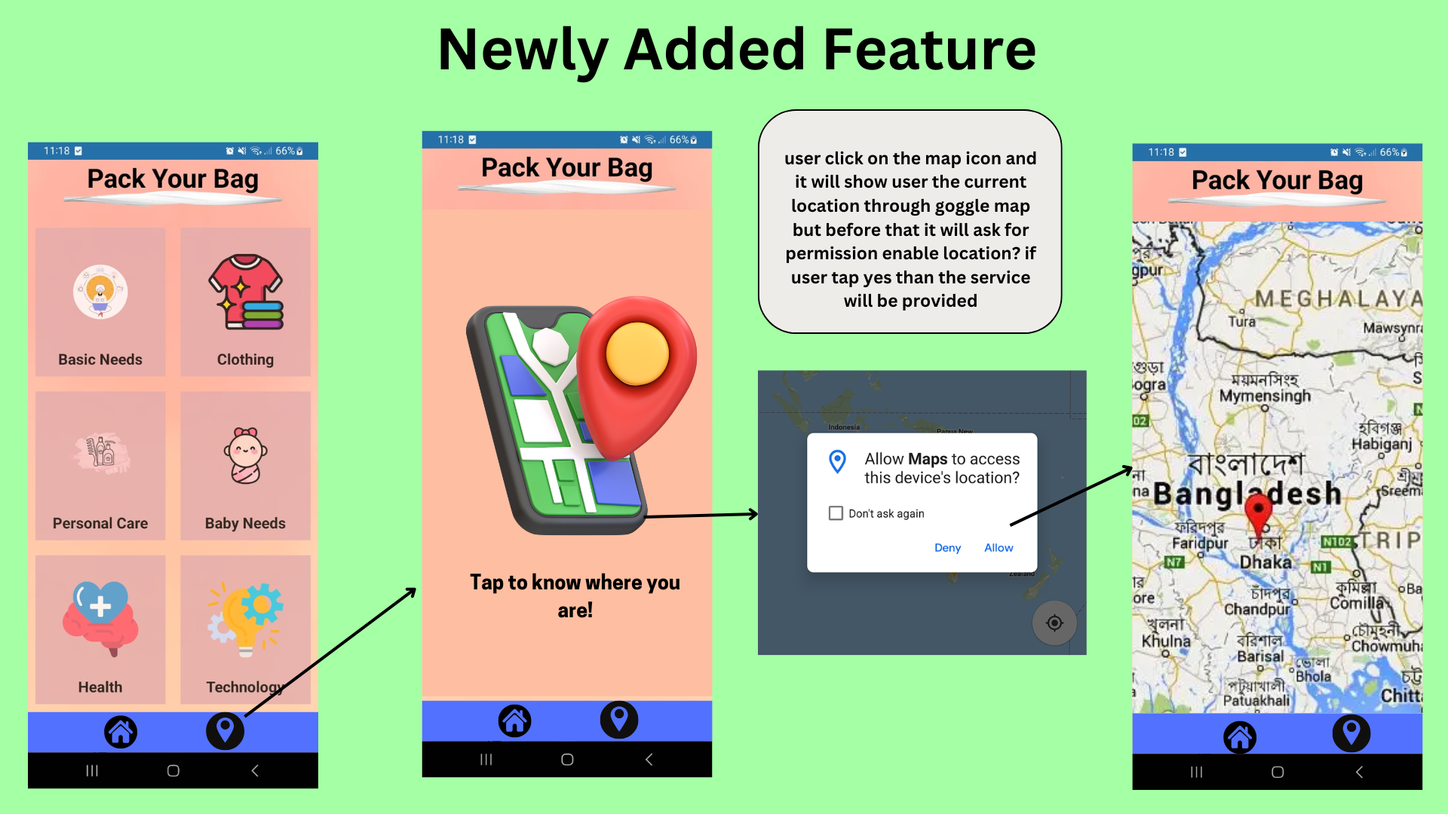
Features
if user click on that map icon he can easily get access to world map via goggle map

Slide 9










My future Plan with this App
Advanced Packing Assistance
Smart Recommendations
Weather Integration
Profiles and Preferences
Sharing on social media
Voice Assistance
Barcode/QR Scanner
Advanced Mapping Features
Integration with Wearable Devices like smartwatches
Capture Travel Moment
Trip Planner Sync with Google Calendar

Slide 10
THANK YOU

